Slide 1


Kwasi Mantey
08/27/2001

Slide 2

Outline
Executive Summary
Introduction
Methodology
Results
Conclusion
Appendix

Slide 3
Executive Summary
Summary of methodologies
Data Collection with API
Data Collection with Web Scraping
Data Wrangling
Exploratory Data Analysis with SQL
Exploratory Data Analysis with Data Visualization
Interactive Visual Analytics with Folium
Machine Learning Prediction

Slide 4
Introduction
As a data scientist working at a new rocket company, I am tasked with determining the estimated price of each launch that our competitor Space X spends.
I will gather relevant information about Space X and create a dashboard that will help my team.
To do this, I will train a machine learning model and use the public information that the company has released to predict whether Space X will reuse rockets from their first stages of launching.

Slide 5

Section 1

Slide 6
Methodology
Executive Summary
Data collection methodology:
Web scraping from sites like Wikipedia and getting requests to Space X’s API
Perform data wrangling
Clean the data and get relevant information
Perform exploratory data analysis (EDA) using visualization and SQL
Perform interactive visual analytics using Folium and Plotly Dash
Perform predictive analysis using classification models
A Machine learning Model will be the best approach for the predictive analysis.

Slide 7
Data Collection
Describe how data sets were collected.
Space X API request
Web Scraping
Obtain the URL of the needed data
Get SpaceX launch data using the GET request
Decode the response as a JSON and turn it into a PANDAS data frame
Use the API to get data about the launches. (ID’s given for each launch)
Filter the data only to have Falcon 9 launches. Replace null values and get the outputs

Slide 8
Data Collection – SpaceX API
Presented is how Data Collection is done on the right in the form of a flow chart
GitHub Link: https://github.com/SleepyKM/Data-Collection/blob/main/jupyter-labs-spacex-data-collection-api.ipynb
Make a request to SpaceX API
Decode the response as a JSON
Turn JSON into pandas data frame
Use the API again to get information about the launches using the IDs given for each launch
Construct our dataset using the data we have collected

Slide 9
Data Collection - Scraping
Presented is how Web Scraping is done on the right in the form of a flow chart
GitHub Link: https://github.com/SleepyKM/Data-Collection/blob/main/jupyter-labs-webscraping.ipynb
Obtain Falcon 9 launch from its Wiki page using the URL
Create a beautiful Soup object from the HTML
Extract all column names from the HTML table
Create an empty dictionary with keys from the column names
Fill the dictionary with launch records extracted from the table rows
Finally convert the dictionary into a CSV dataset

Slide 10
Data Wrangling
Presented is how Data Wrangling is done on the right in the form of a flow chart
GitHub Link: https://github.com/SleepyKM/Data-Collection/blob/main/labs-jupyter-spacex-Data%20wrangling.ipynb
Calculate the number of launches on each site
Calculate the number and occurrences of each orbit
Calculate the number and occurrence of mission outcomes per orbit type
Create a landing outcome label from the outcome column

Slide 11
EDA with Data Visualization
Types of Charts used:
Scatter plot – Flight vs Payload, Flight Number vs Launch sites, Payload and Launch Sites, Flight Number and Orbit Types, Payload and Orbit Types.
Bar Chart – Measured the success rate of each orbit
Line Plot – Measured the success and Date of each orbit
EDA GitHub link: https://github.com/SleepyKM/Data-Collection/blob/main/edadataviz.ipynb

Slide 12
EDA with SQL
Summary of SQL queries used:
Displayed the names of the unique launch sites in the space mission
Displayed 5 records where launch sites begin with the string CCA
Displayed the total payload mass carried by boosters launched by NASA (CRS)
Display average payload mass carried by booster version F9 v1.1
Listed the date when the first successful landing outcome in the ground pad was achieved
Listed the names of the boosters which have success in drone ships and have payload mass greater than 4000 but less than 6000
Listed the total number of successful and failed outcomes
Listed the names of the booster versions which have carried a maximum payload mass. (Used a subquery)
Listed the failed landing outcomes in the drone ships, booster versions, and launch site names for the year.
Ranked the landing outcomes between the date 2010-06-04 and 2017-03-20, in descending order.
GitHub link: https://github.com/SleepyKM/Data-Collection/blob/main/jupyter-labs-eda-sql-coursera_sqllite.ipynb

Slide 13
Build an Interactive Map with Folium
Folium Markers were used to show Space X’s launch sites and their nearest landmarks such as railways, highways, cities, and coastlines.
Polylines were used to connect the launch sites to the nearest landmarks.
Red represents the launch failures
Green represents the successful launches
GitHub link: https://github.com/SleepyKM/Data-Collection/blob/main/lab_jupyter_launch_site_location.ipynb

Slide 14
Build a Dashboard with Plotly Dash
Pie charts and Scatter charts were used to visualize Space X’s launch records.
These charts displayed the rocket launch success rate per site and could see the factors that influenced the success rate of each site.
Successful launches were represented by the number 1
Failed launches were represented by 0.

Slide 15
Predictive Analysis (Classification)
Scikit-learn is a machine-learning library that is used for predictive analysis.
Created a machine learning pipeline to predict if the first-stage rocket will land with the given data.
GitHub Link: https://github.com/SleepyKM/Data-Collection/blob/main/SpaceX_Machine%20Learning%20Prediction_Part_5.ipynb
Create a column for the class
Standardize the data
Split the data into a test and training sets
Create a grid search CV object and fit the different ML objects
Calculate the accuracy of the test data
Choose the best ML method
Compare the predictions with the real labels

Slide 16
Results
The EDA has shown us that the successful landing outcomes relate to the flight number. It was shown that there has been an increase in successful landing since 2015.
Launch sites were located near the coastline, it is believed that it is easier to be tested in the water.
Other sites include highways and railways because of how equipment and research materials can be transported
The ML was able to predict the landing of rockets with a success rate of 83.33%

Slide 17

Section 2

Slide 18
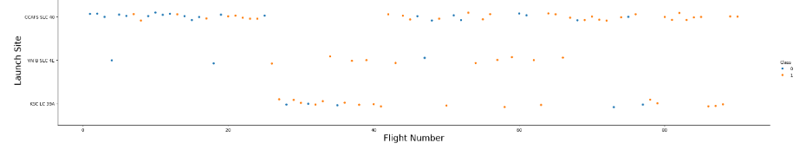
Flight Number vs. Launch Site
There were more successful landings as the flight numbers increased.
Launch site CCCAFS SLC 40 had the most landings.

Slide 19
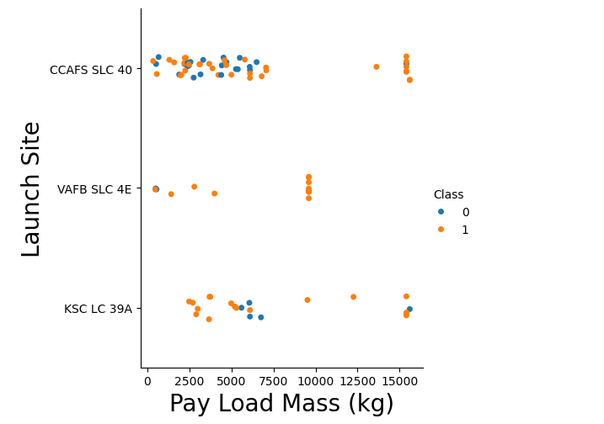
Payload vs. Launch Site
The VAFB-SLC launch site had no rockets launched for a heavy payload mass that was greater than 10,000 (kg).

Slide 20
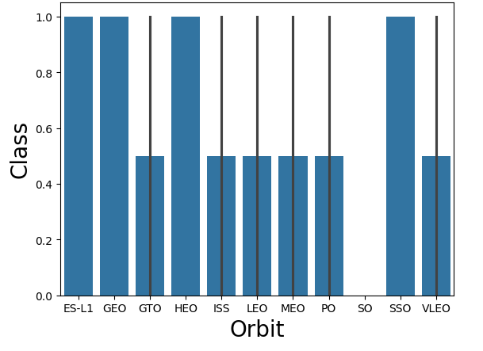
Success Rate vs. Orbit Type
The Highest success rate orbits are:
ES-L1
GEO
SSO
HEO

Slide 21
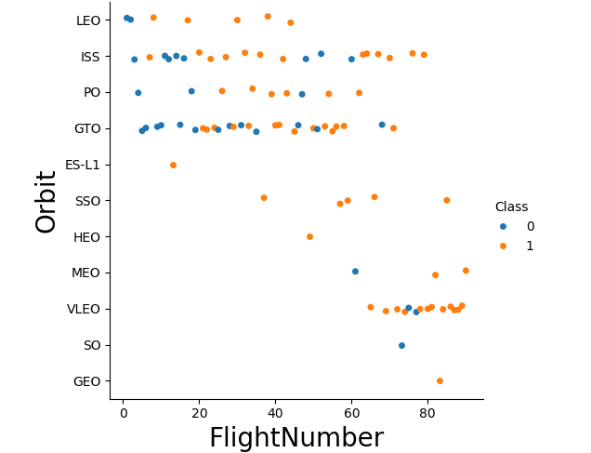
Flight Number vs. Orbit Type
The Leo orbit success appears to be related to the number of flights.
There is no relationship between the flight number when in GTO orbit
AS the flight numbers increased, so did the success rate.

Slide 22
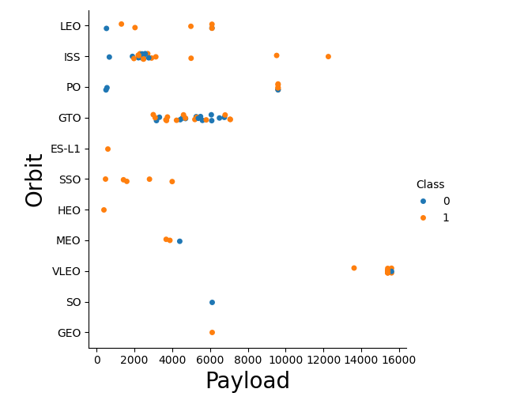
Payload vs. Orbit Type
Polar, LEO, and ISS had the most successful landings with heavy payloads
As shown in the scatter graph, there isn’t a clear indication of success or failure for GTO

Slide 23
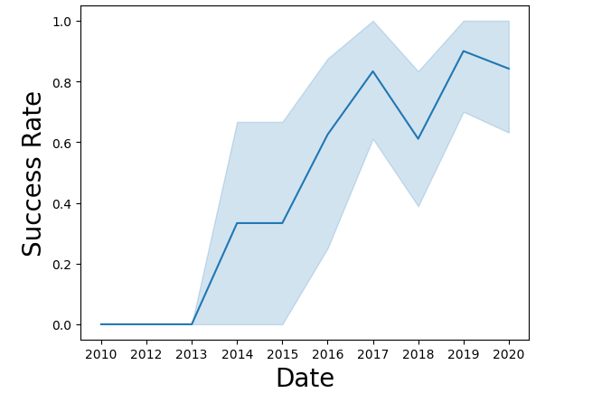
Launch Success Yearly Trend
There has been a massive increase in the success rates of the launch at the start of 2013

Slide 24
All Launch Site Names
These are the names of the launch sites where the different rocket landings were attempted:
CCAFS LC – 40
CCAFS SLC – 40
KSC LC – 39A
VAFB SLC – 4E

Slide 25
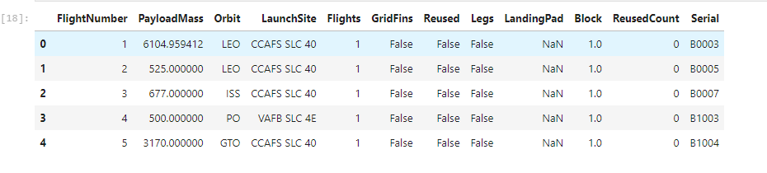
Launch Site Names Begin with 'CCA'
We can see that other companies besides Space X were testing their rockets.

Slide 26
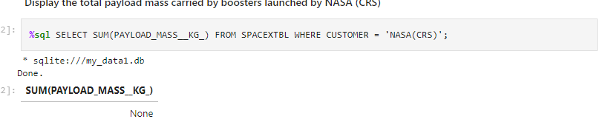
Total Payload Mass
This shows the total payload mass carried by boosters launched by NASA which is none.

Slide 27
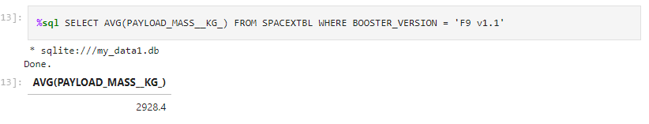
Average Payload Mass by F9 v1.1
The average payload mass carried by F9 v1.1 was 2928.4

Slide 28
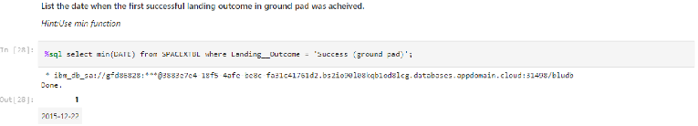
First Successful Ground Landing Date
The first successful ground pad was on 22 December 2015

Slide 29
Successful Drone Ship Landing with Payload between 4000 and 6000
There were only 4 boosters with a payload mass between 4000 and 6000 they:
F9 FT B1022
F9 FT B1026
F9 FT B1021.2
F9 FT B1031.2

Slide 30
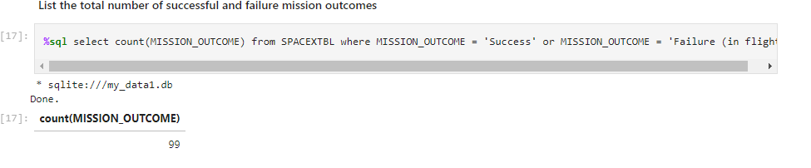
Total Number of Successful and Failure Mission Outcomes
The above picture shows the total number of successful and failure mission outcomes.

Slide 31
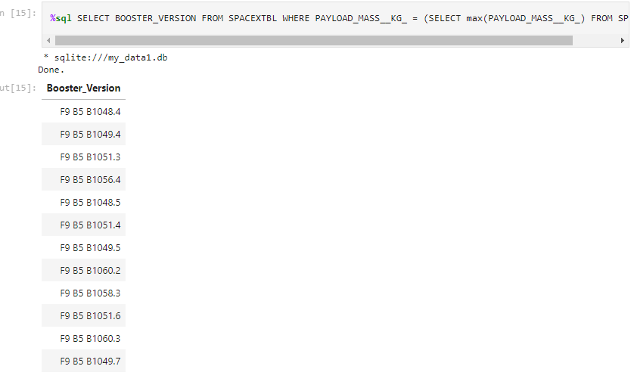
Boosters Carried Maximum Payload
In the picture above, it shows that the 12 boosters have carried the maximum payload mass of 15600kg.

Slide 32
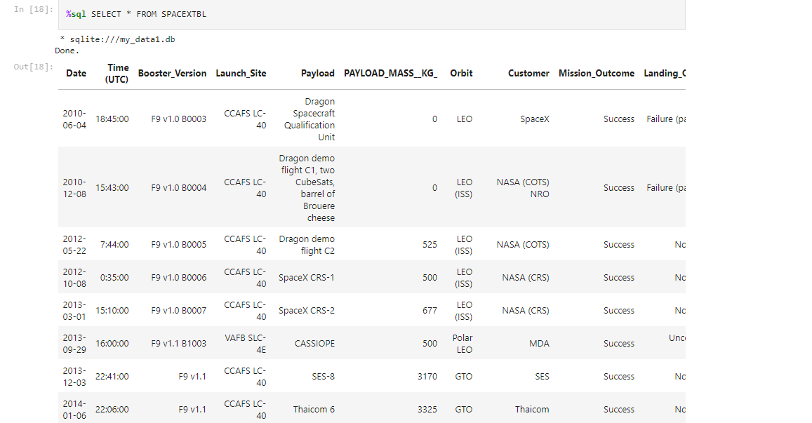
2015 Launch Records
2 boosters F9 v1. 1B1012_CCAFS LC-40 and F9v1. 1B1015 CCAFS LC-40 failed to land in 2015

Slide 33
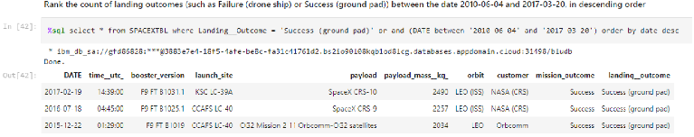
Rank Landing Outcomes Between 2010-06-04 and 2017-03-20
The number of successful landings have increased since 2015

Slide 34

Section 3

Slide 35
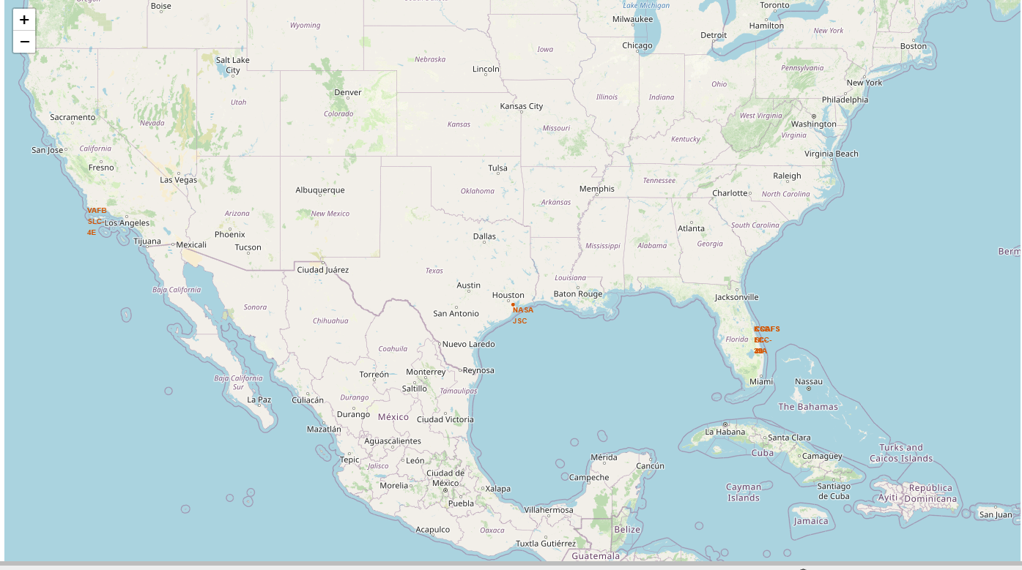
Launch Site Locations
All launch sites are in very close proximity to the coast, and they are also a thousand kilometers away from the equator line.

Slide 36
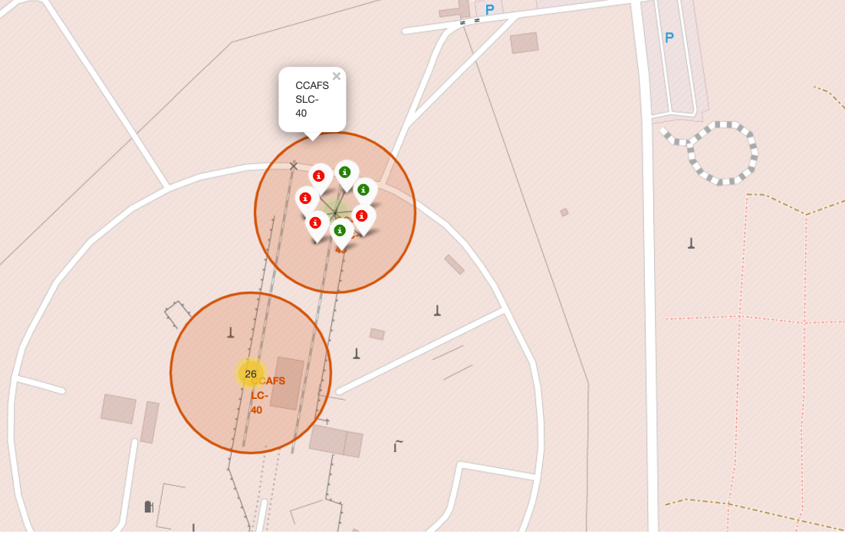
Success Rate of Rocket Launches
The successful launches are represented by a green marker while the red marker represents failed rocket launches.

Slide 37
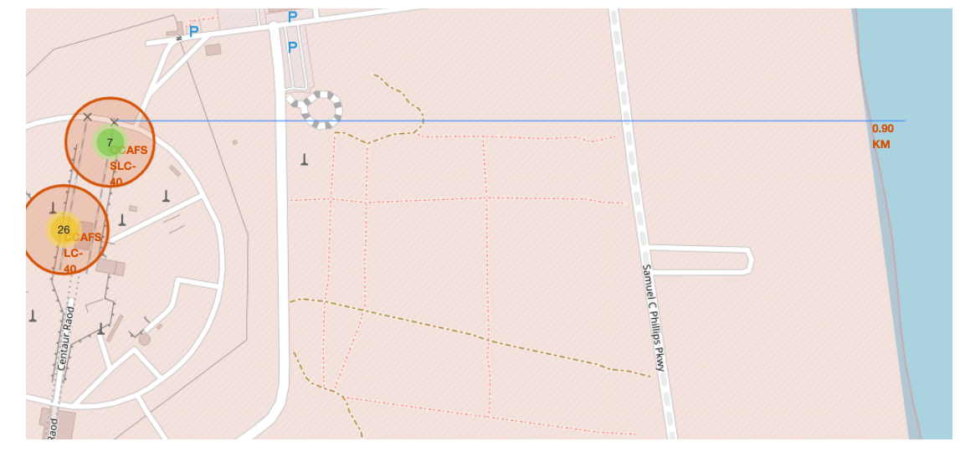
Surrounding Landmarks
It appears that launch sites are usually set up away from cities. This may be because of the desire to prevent any crashes near populated areas.
Launch sites are in very close proximity to railways and highways due to the necessary transportation requirements for rocket parts and other materials.
The sites are very close to the coastline this is because many rockets landing tests were near bodies of waters

Slide 38

Section 4

Slide 39
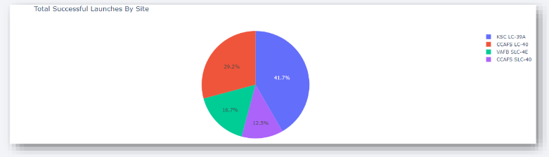
Successful Launches by Site
As seen on the plots that site KSC LC-39A has the largest successful launches as well as the highest launch success rates

Slide 40
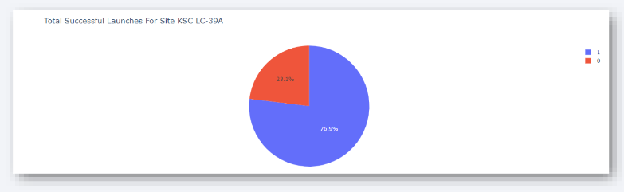
Total Successful Launches for Site KSC LC-39A
It is shown that 76.9% of the total launches at sites KSC LC39A were successful this is the highest success rate of all the different launches.

Slide 41
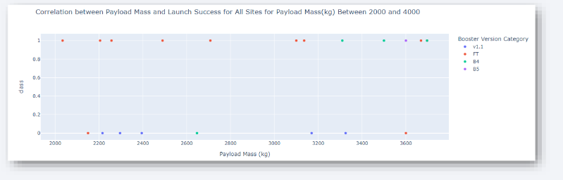
Payload Mass vs. Launch Success for All Sites
The payload range between 2000 KG and 4000 KG has the highest success rate.

Slide 42

Section 5

Slide 43
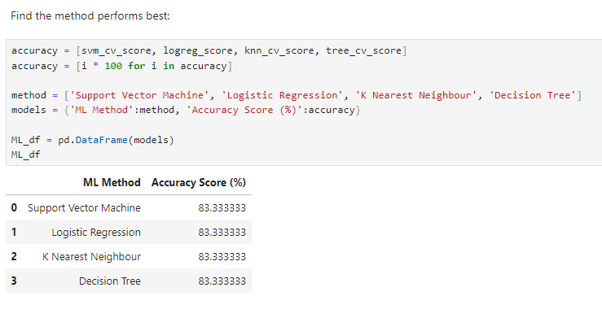
Classification Accuracy
We use the logistic regression for classification because we can see that all the models have an identical accuracy score of 83.33%

Slide 44
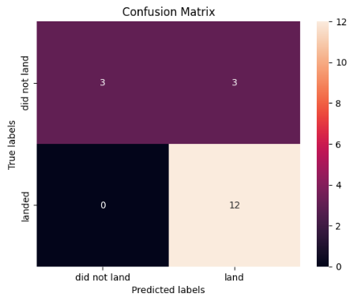
Confusion Matrix
This chart shows the confusion matrix of the logistic regression model that was chosen
The model only failed to accurately predict 3 labels.

Slide 45
Conclusions
To compete with SpaceX through this process a general picture of their successful methods was:
All their launch sites were located near the coast and away from cities this enabled them to test their rocket landings without conflicts
Site KSC LC39A had the highest launch success rate out of all the other launch sites
From 2015 the success rate of rocket landings significantly increased and was also apparent that landing success had increased with their flight number
Finally, all this data was used to train a machine learning model that can predict the lending outcome of rocket launches with an 83.33% accuracy.

Slide 46


